Slide 1
CCChat
By Oliver Schneider & Leonid Immel

Slide 2
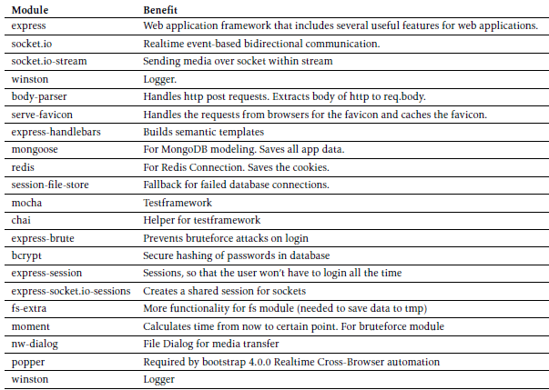
Node Modules (Serverside)

Slide 3
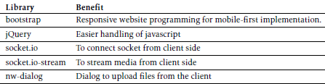
Vendor Libraries (Clientside)

Slide 4
Project Structure
App
Public (all static served files)
Js
Css
Vendor
Services (All services for the app (for example login Service and chat Service)
Index
Login
Chat
Microservices (contains all microservices for chat module)
Modules (functionality and code shared in the whole app (database, logger, sockets,…))
Tests (applicationtests)
Layouts (Layouts for the handlebars)
Certs (Certification files for the https)
Tmp (all tmp files: logs, modules for handlebars,…)

Slide 5
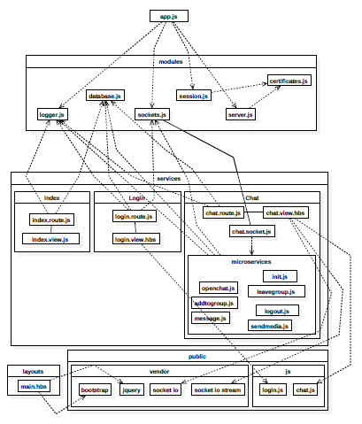
Components

Slide 6
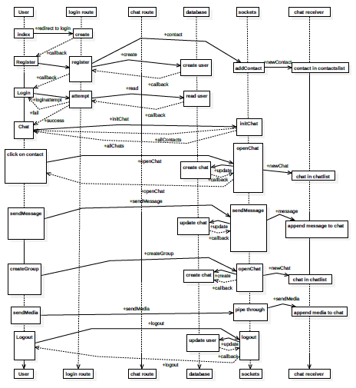
Sequence diagram

Slide 7
Implemented extra features
Bruteforce prevention
Bcrypt encrypted passwords
Session with cookies
Logging
Unique chat ids

Slide 8
Lessons learned
Never reuse a socket within a socket.on function
Use node_modules whenever possible
Handlebars needs all views in one folder (-> annoying!)

